Slide 2
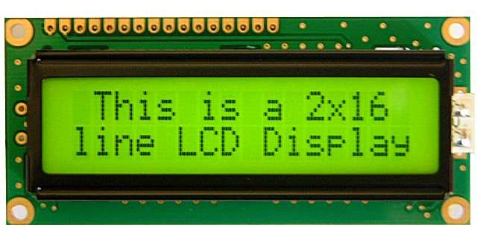
HD44780 LCD
An alphanumeric low cost LCD Display is very essential for may small and big projects to Display various type of information.
Hitachi HD44780 Chipset based 16x2 char LCD is Really very cheap and easily available in the local market.

Slide 3
HD44780 LCD
PIN NUMBER | SYMBOL | FUNCTION
1 | Vss | GND
2 | Vdd | + 3V or + 5V
3 | Vo | Contrast Adjustment
4 | RS | H/L Register Select Signal
5 | R/W | H/L Read/Write Signal
6 | E | H → L Enable Signal
7 | DB0 | H/L Data Bus Line
8 | DB1 | H/L Data Bus Line
9 | DB2 | H/L Data Bus Line
10 | DB3 | H/L Data Bus Line
11 | DB4 | H/L Data Bus Line
12 | DB5 | H/L Data Bus Line
13 | DB6 | H/L Data Bus Line
14 | DB7 | H/L Data Bus Line
15 | A/Vee | + 3.5V for LED/Negative Voltage Output
16 | K | K Power Supply for B/L (OV)

Slide 4
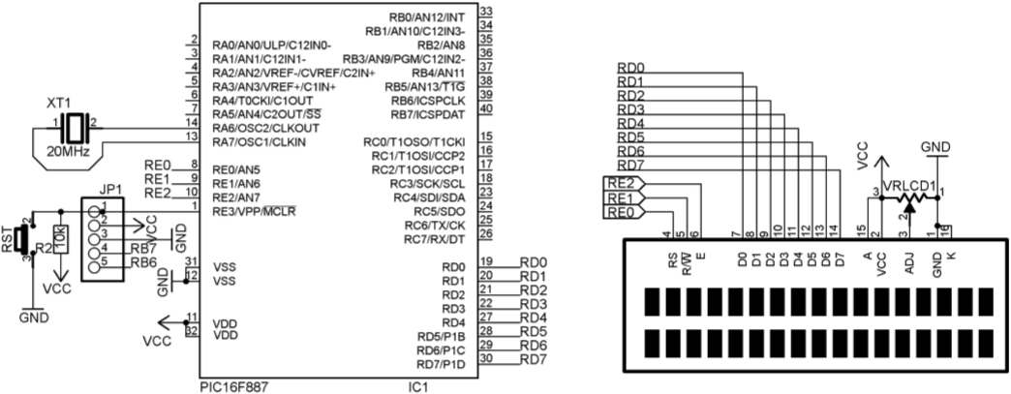
SCHEMATIC

Slide 5
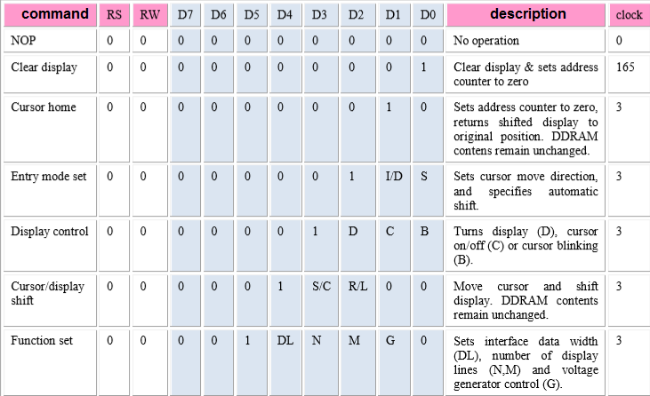
HD44780 LCD COMMANDS

Slide 6
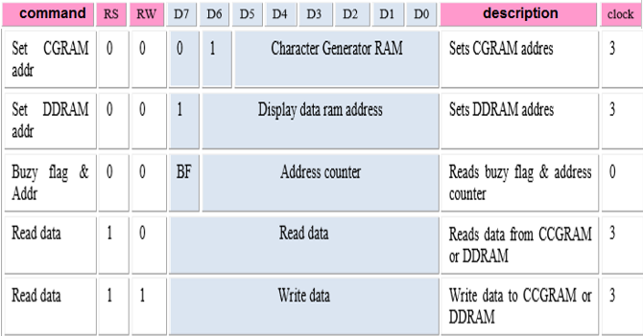
HD44780 LCD COMMANDS

Slide 7
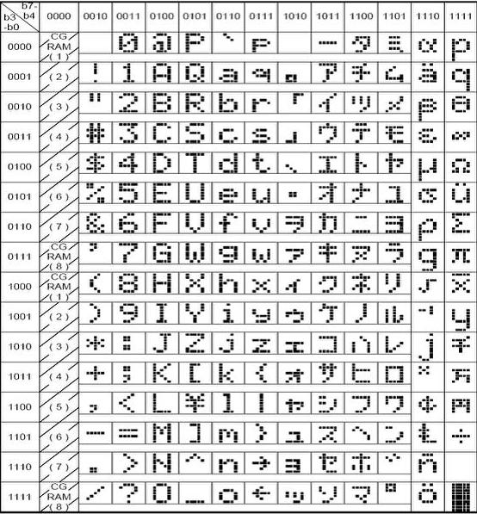
HD44780 LCD COMMANDS

Slide 8
IMPORTANT COMMANDS
COMMAND | DESCRIPTION
0x38 | Used 8 bit mode, enable display on 2 lines, dot matrix is 5x7
0x0C | Turn on display, turn off cursor
0X06 | Cursor auto shift right
0x01 | Clear display
0x80 | Start address of line 1
0xC0 | Start address of line 2

Slide 9
STEPS TO WRITE LCD
Clear pin RW
Control pin RS base on what you want to write
Command : RS = 0
Data : RS = 1
3. Output what you want to write to data lines( D0-D7)
4. Output one pulse from pin E
5. Delay to wait for LCD handling

Slide 10
EXAMPLE 1
Control LCD display string “Test LCD 16x2” on line 2

Slide 11
SCHEMATIC
Control LCD display string “Test LCD 16x2” on line 2

Slide 12
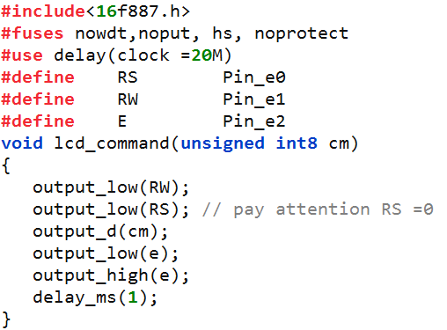
CODE

Slide 13
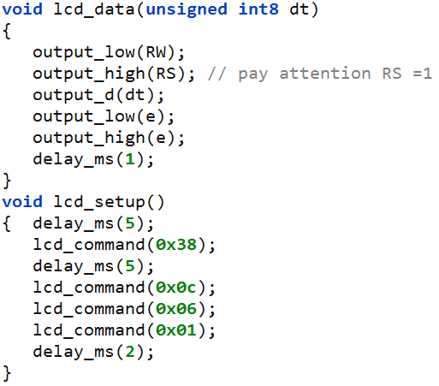
CODE

Slide 14
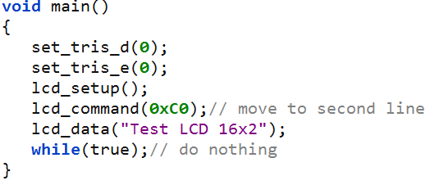
CODE

Slide 15
EXAMPLE 2
Control LCD display the count number from 0 to 20 on center of line 2

Slide 16
SCHEMATIC
Control LCD display string “Test LCD 16x2” on line 2

Slide 17
CODE

Slide 18
CODE

Slide 19
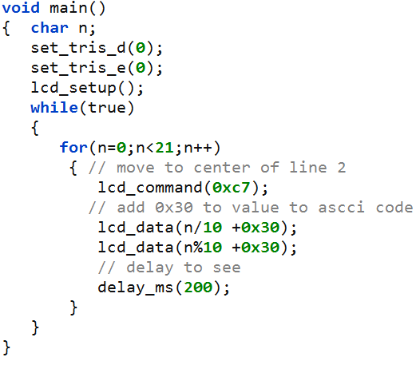
CODE

Slide 20
Test the theory by simulink

Slide 21
Thank You !

